Slide 1
BMC Cyber and Cloud Summer Courses Deep Learning for Computer Vision Advanced CNN Architectures
Samuel Adebayo
sadebayo@belfastmet.ac.uk

Slide 2
Yesterday
We looked at the basics of Computer Vision.
Then we looked at, Convolution operations.
CNN Architectures
Writing up your own architecture code.
Training your own CNN architecture.
Testing, etc.

Slide 3
Today
More Advanced CNN Architectures
ResNet,
Inception
DenseNet

Slide 4
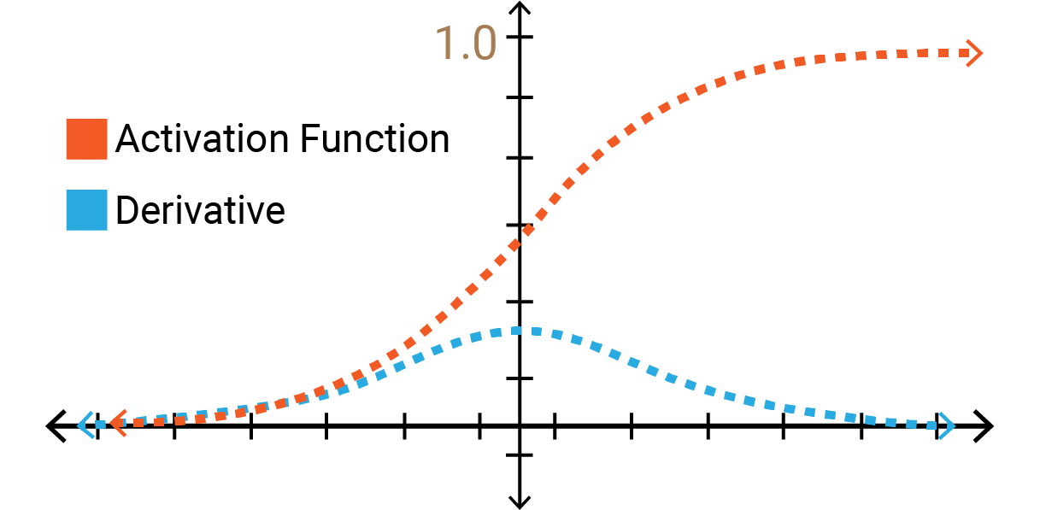
Motivation for Advanced Architectures
Deeper Networks often lead to vanishing/exploding gradients.
Vanishing gradient problem is a phenomenon that occurs during the training of deep neural networks when the gradients used to update the network become very small or vanish. This often happens when the gradients are backpropagated from the output layers to the earlier layers.
Hence, when gradients vanish, the network can’t learn from the past and loses its ability to capture long-term dependencies. This can lead to poor generalisation and underfitting.
Need for more efficient parameter utilization.
Desire to learn more complex and hierarchical features.

Slide 5
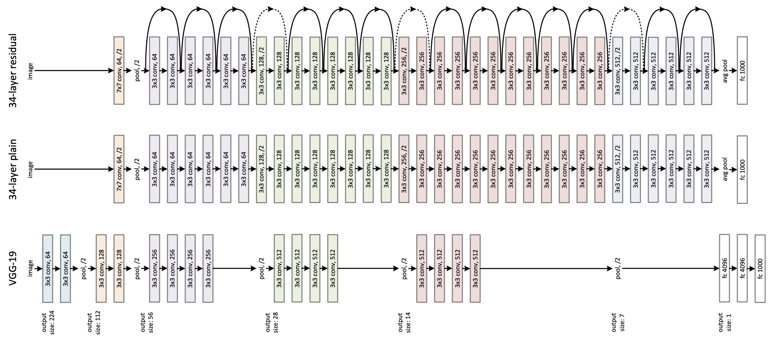
Introducing ResNet model architectures

Slide 6
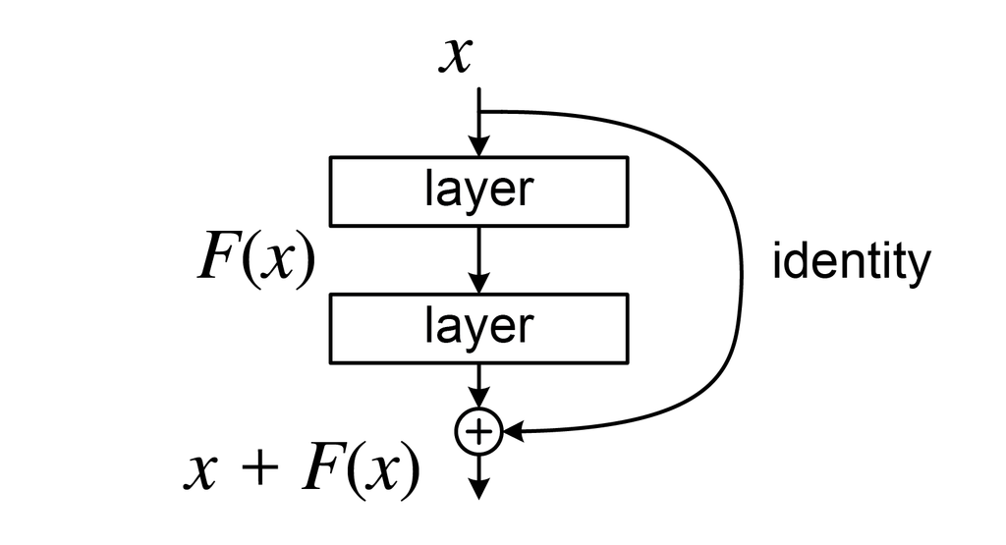
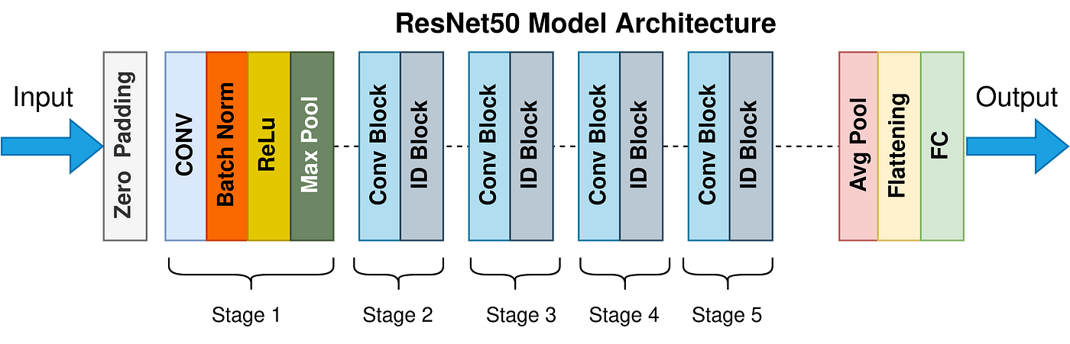
Introduction to ResNet
Residual Networks (Networks) introduced by He et al. (2015)
Key idea: Residual connections or “skip connections”
ResNet’s impact on mitigating the vanishing gradient problem.

Slide 7
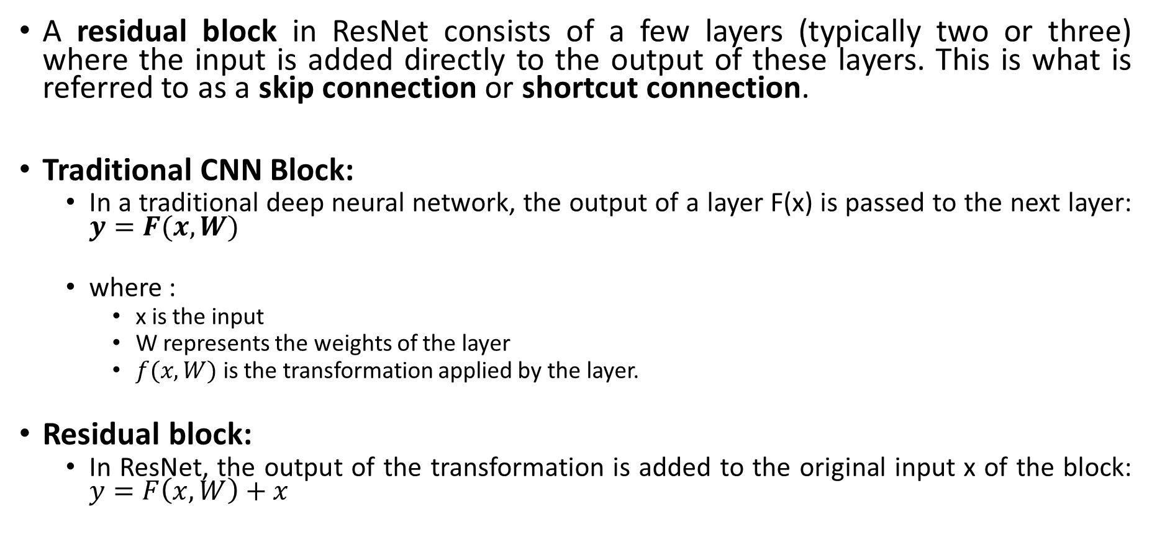
ResNet Components
A residual block in ResNet consists of a few layers (typically two or three) where the input is added directly to the output of these layers. This is what is referred to as a skip connection or shortcut connection.
Traditional CNN Block:
In a traditional deep neural network, the output of a layer F(x) is passed to the next layer: $y=F(x, W)$
where :
x is the input
W represents the weights of the layer
$f(x, W)$ is the transformation applied by the layer.
Residual block:
In ResNet, the output of the transformation is added to the original input x of the block: $y=F\left(x, W\right)+x$

Slide 8
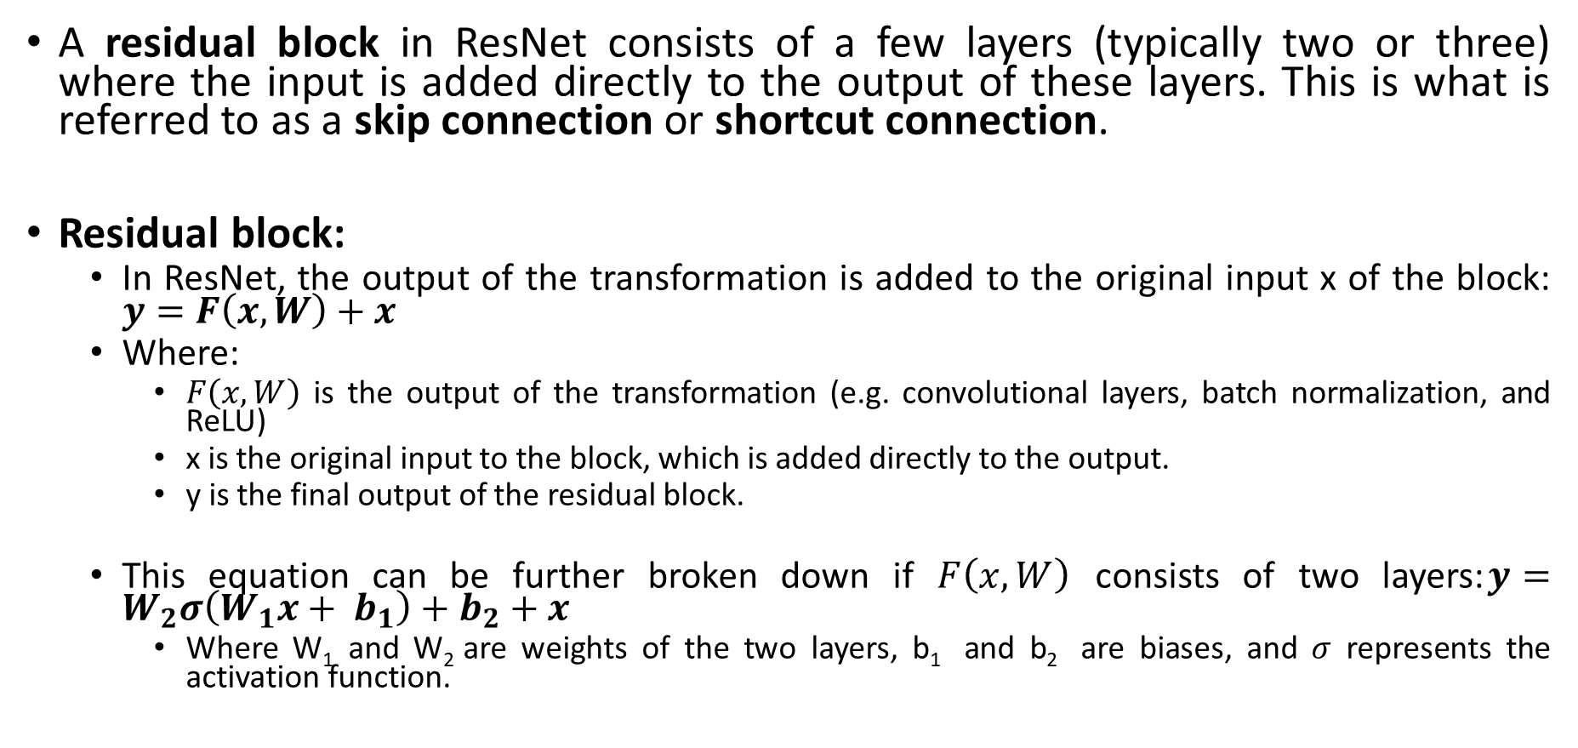
ResNet Components
A residual block in ResNet consists of a few layers (typically two or three) where the input is added directly to the output of these layers. This is what is referred to as a skip connection or shortcut connection.
Residual block:
In ResNet, the output of the transformation is added to the original input x of the block: $y=F\left(x, W\right)+x$
Where:
$F\left(x, W\right)$ is the output of the transformation (e.g. convolutional layers, batch normalization, and ReLU)
x is the original input to the block, which is added directly to the output.
y is the final output of the residual block.
This equation can be further broken down if $F\left(x, W\right)$ consists of two layers:$y=W_{2}σ\left(W_{1}x+ b_{1}\right)+b_{2}+x$
Where W₁ and W₂ are weights of the two layers, b₁ and b₂ are biases, and $σ$ represents the activation function.

Slide 9
Why Residual Connections
Residual connections help mitigate the vanishing gradient problem in deep networks, where gradients become exceedingly small as they are backpropagated through layers. By adding the input directly to the output, the model can more easily propagate gradients back through the network, making it easier to train very deep networks.

Slide 10
Naming Conventions of ResNet Variants
ResNet models are named based on the depth of the network, which refers to the number of layers (or learnable weights) within the model.
ResNet-18
Structure: ResNet-18 consists of 18 layers with learnable weights. These include convolutional layers and fully connected layers.
Composition: Specifically, it consists of 8 residual blocks (2 layers each) plus an initial convolutional layer and a final fully connected layer. The detailed breakdown is:
1 initial convolutional layer (conv1)
8 convolutional layers within residual blocks (conv2_x, conv3_x, conv_4x, conv_5x)
1 fully connected layer (fc)
Total: 1 + 2*8 + 1 = 18 layers.

Slide 11
Naming Conventions of ResNet Variants
ResNet models are named based on the depth of the network, which refers to the number of layers (or learnable weights) within the model.
ResNet-50, ResNet-101, and ResNet-152
Structure: These models use "bottleneck" layers within each residual block, where a 1x1 convolution reduces the dimensionality (channel depth), a 3x3 convolution processes the data, and another 1x1 convolution restores the dimensionality.
Composition: The number (50, 101, 152) indicates the total number of layers, including the bottleneck layers:
ResNet-50 has 50 layers.
ResNet-101 has 101 layers.
ResNet-152 has 152 layers.

Slide 12
ResNet: Key Takeaways
Residual Learning: The core idea is to add a shortcut connection that skips one or more layers, helping to mitigate the vanishing gradient problem.
Model Depth: The numbers in ResNet models (18, 34, 50, etc.) represent the total number of learnable layers in the network.
Model Selection: The choice between ResNet-18, ResNet-34, ResNet-50, etc., depends on the complexity of the task, the amount of data available, and the computational resources at hand.

Slide 14

Thank You
See you soon

